Slide 1
Sun, L., & Widdicks, M. (2016). Why do employees like to be paid with Options? - A multi- period prospect theory approach. Journal of Corporate Finance, 38, 106-125.
0927 meeting

Slide 2
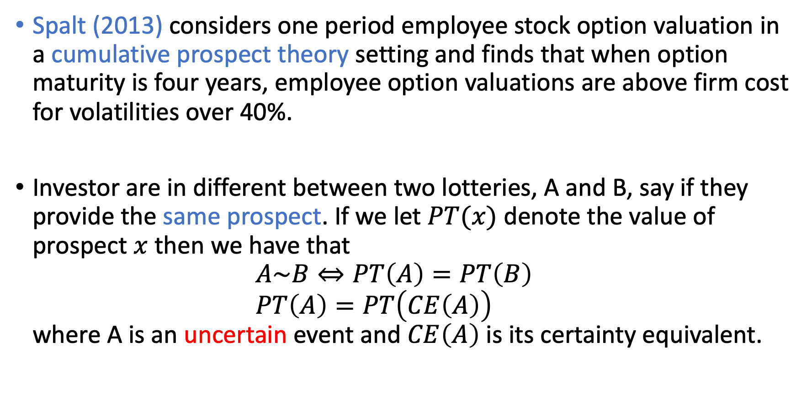
Cumulative Prospect Theory model
Spalt (2013) considers one period employee stock option valuation in a cumulative prospect theory setting and finds that when option maturity is four years, employee option valuations are above firm cost for volatilities over 40%.
Investor are in different between two lotteries, A and B, say if they provide the same prospect. If we let $PT(x)$ denote the value of prospect $x$ then we have that $A\sim B⇔PT\left(A\right)=PT\left(B\right)$ $PT\left(A\right)=PT\left(CE\left(A\right)\right)$ where A is an uncertain event and $CE\left(A\right)$ is its certainty equivalent.

Slide 3
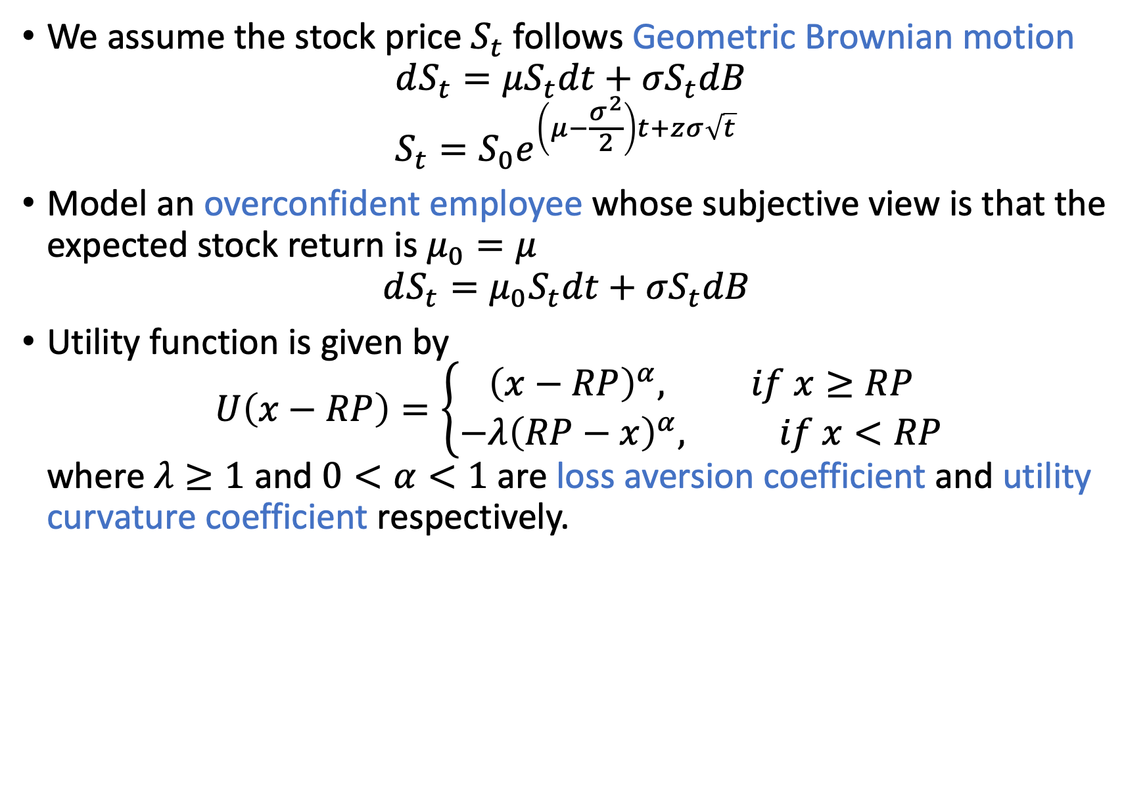
Cumulative Prospect Theory model
We assume the stock price $S_{t}$ follows Geometric Brownian motion $dS_{t}=μS_{t}dt+σS_{t}dB$ $S_{t}=S_{0}e^{\left(μ−\frac{σ^{2}}{2}\right)t+zσ\sqrt{t}}$
Model an overconfident employee whose subjective view is that the expected stock return is $μ_{0}=μ$ $dS_{t}=μ_{0}S_{t}dt+σS_{t}dB$
Utility function is given by $U\left(x−RP\right)=\left\{\begin{aligned}{\left(x−RP\right)}^{α}, if x≥RP \\ −λ{\left(RP−x\right)}^{α}, if x<RP\end{aligned}\right.$ where $λ≥1$ and $0<α<1$ are loss aversion coefficient and utility curvature coefficient respectively.

Slide 4
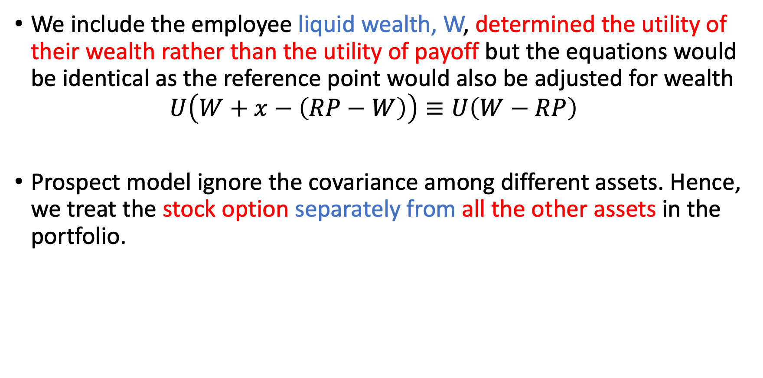
Cumulative Prospect Theory model
We include the employee liquid wealth, W, determined the utility of their wealth rather than the utility of payoff but the equations would be identical as the reference point would also be adjusted for wealth $U\left(W+x−\left(RP−W\right)\right)≡U\left(W−RP\right)$
Prospect model ignore the covariance among different assets. Hence, we treat the stock option separately from all the other assets in the portfolio.

Slide 5
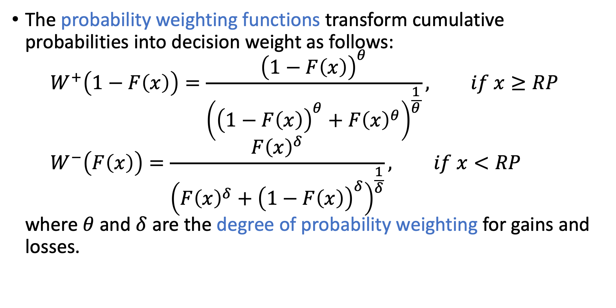
Cumulative Prospect Theory model
The probability weighting functions transform cumulative probabilities into decision weight as follows: $W^{+}\left(1−F\left(x\right)\right)=\frac{{\left(1−F\left(x\right)\right)}^{θ}}{{\left({\left(1−F\left(x\right)\right)}^{θ}+F{\left(x\right)}^{θ}\right)}^{\frac{1}{θ}}}, if x≥RP$ $W^{−}\left(F\left(x\right)\right)=\frac{F{\left(x\right)}^{δ}}{{\left(F{\left(x\right)}^{δ}+{\left(1−F\left(x\right)\right)}^{δ}\right)}^{\frac{1}{δ}}}, if x<RP$ where $θ$ and $δ$ are the degree of probability weighting for gains and losses.

Slide 6
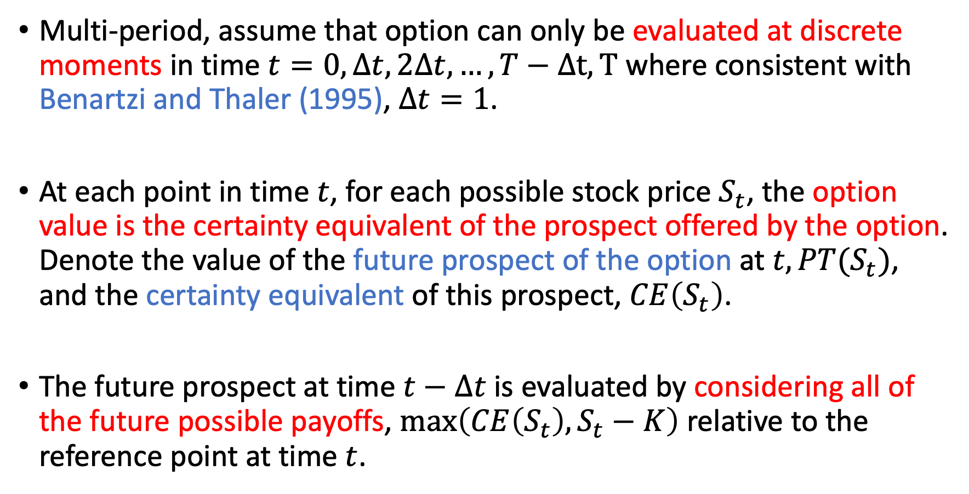
Cumulative Prospect Theory model
Multi-period, assume that option can only be evaluated at discrete moments in time $t=0, Δt, 2Δt, …, T−Δt, T$ where consistent with Benartzi and Thaler (1995), $Δt=1$.
At each point in time $t$, for each possible stock price $S_{t}$, the option value is the certainty equivalent of the prospect offered by the option. Denote the value of the future prospect of the option at $t, PT(S_{t})$, and the certainty equivalent of this prospect, $CE\left(S_{t}\right)$.
The future prospect at time $t−Δt$ is evaluated by considering all of the future possible payoffs, $\max\left(CE\left(S_{t}\right), S_{t}−K\right)$ relative to the reference point at time $t$.

Slide 7
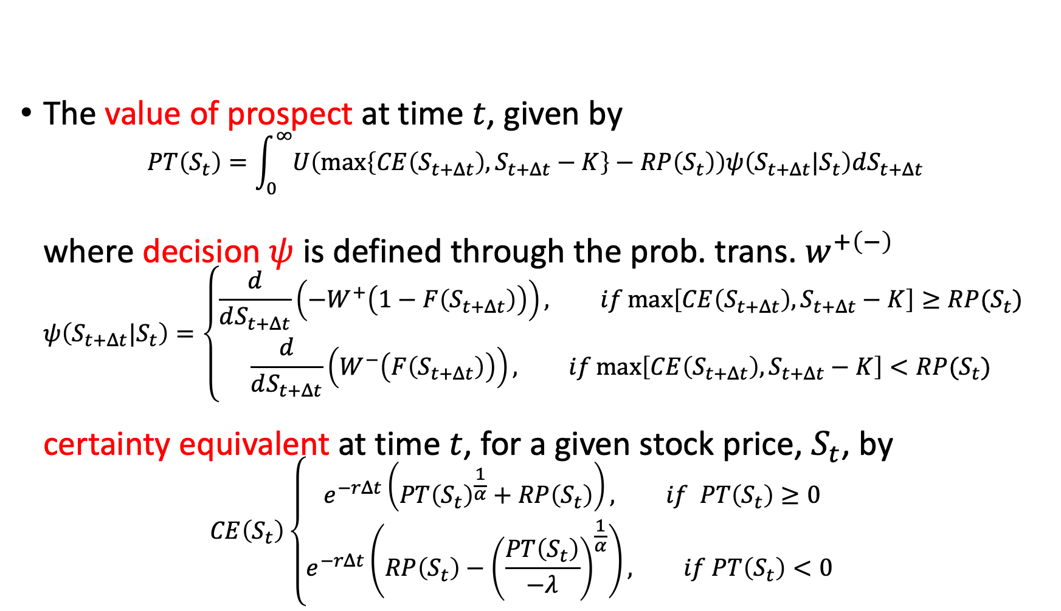
Cumulative Prospect Theory model
The value of prospect at time $t$, given by $PT\left(S_{t}\right)=\int_{0}^{∞}{U\left(\max\left\{CE\left(S_{t+Δt}\right), S_{t+Δt}−K\right\}−RP\left(S_{t}\right)\right)ψ\left(S_{t+Δt}|S_{t}\right)dS_{t+Δt}}$ where decision $ψ$ is defined through the prob. trans. $w^{+\left(−\right)}$ $ψ\left(S_{t+Δt}|S_{t}\right)=\left\{\begin{aligned}\frac{d}{dS_{t+Δt}}\left(−W^{+}\left(1−F\left(S_{t+Δt}\right)\right)\right), if\max\left[CE\left(S_{t+Δt}\right), S_{t+Δt}−K\right]≥RP(S_{t}) \\ \frac{d}{dS_{t+Δt}}\left(W^{−}\left(F\left(S_{t+Δt}\right)\right)\right), if\max\left[CE\left(S_{t+Δt}\right), S_{t+Δt}−K\right]<RP(S_{t})\end{aligned}\right.$ certainty equivalent at time $t$, for a given stock price, $S_{t}$, by $CE\left(S_{t}\right)\left\{\begin{aligned}e^{−rΔt}\left(PT{\left(S_{t}\right)}^{\frac{1}{α}}+RP\left(S_{t}\right)\right), if PT\left(S_{t}\right)≥0 \\ e^{−rΔt}\left(RP\left(S_{t}\right)−{\left(\frac{PT\left(S_{t}\right)}{−λ}\right)}^{\frac{1}{α}}\right), if PT\left(S_{t}\right)<0 \end{aligned}\right.$

Slide 8
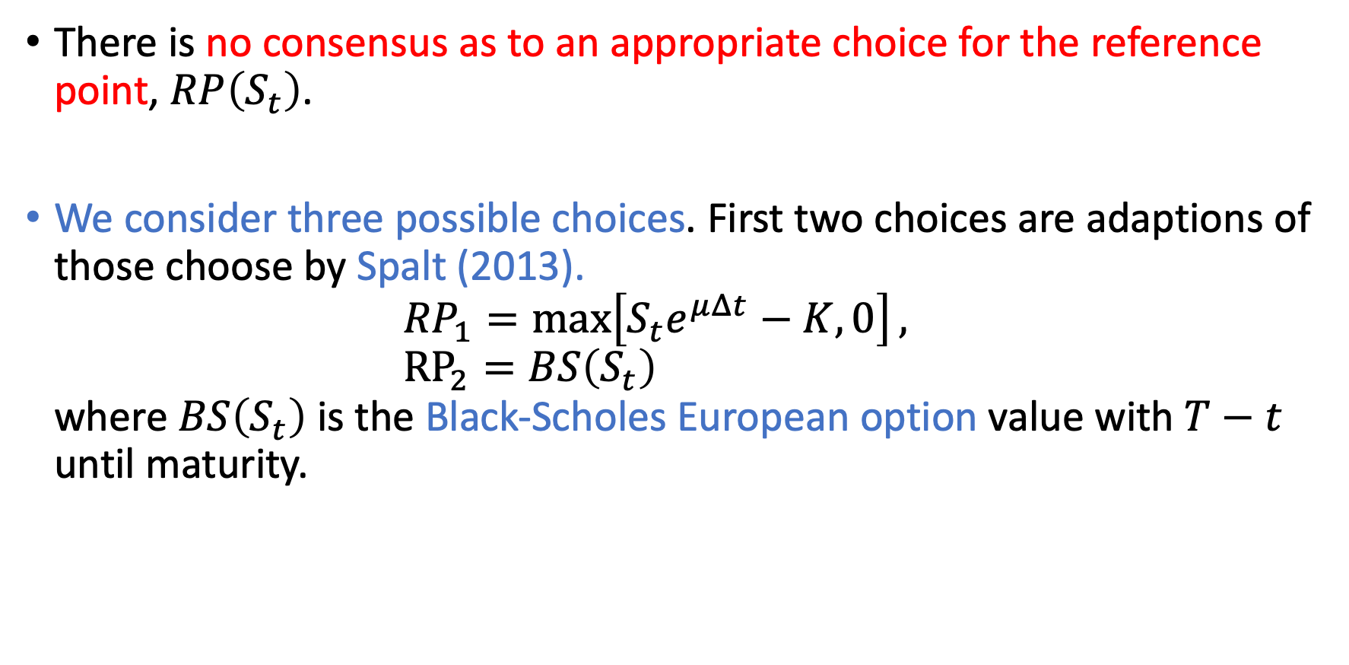
Cumulative Prospect Theory model
There is no consensus as to an appropriate choice for the reference point, $RP\left(S_{t}\right)$.
We consider three possible choices. First two choices are adaptions of those choose by Spalt (2013). ${RP}_{1}=\max\left[S_{t}e^{μΔt}−K, 0\right],$ ${RP}_{2}=BS\left(S_{t}\right)$ where $BS\left(S_{t}\right)$ is the Black-Scholes European option value with $T−t$ until maturity.

Slide 9
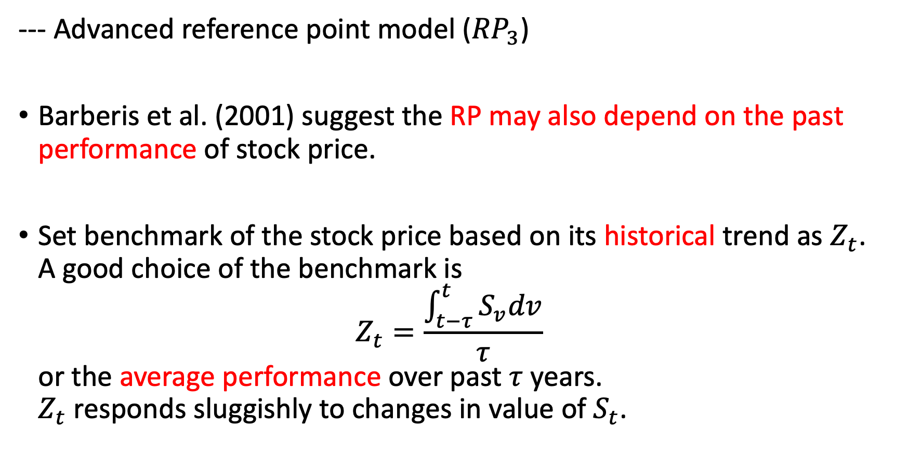
Cumulative Prospect Theory model
--- Advanced reference point model (${RP}_{3}$)
Barberis et al. (2001) suggest the RP may also depend on the past performance of stock price.
Set benchmark of the stock price based on its historical trend as $Z_{t}$. A good choice of the benchmark is $Z_{t}=\frac{\int_{t−τ}^{t}{S_{v}dv}}{τ}$ or the average performance over past $τ$ years. $Z_{t}$ responds sluggishly to changes in value of $S_{t}$.

Slide 10

Cumulative Prospect Theory model
We introduce an indicator $z_{t}$, defined as the ratio of $Z_{t}$ to $S_{t}$, $z_{t}=\frac{Z_{t}}{S_{t}}$.
We still need to define a standard RP so we use the $RP_{1}\left(S_{t}\right)=\max\left[S_{t}e^{μΔt}−K, 0\right]$ in this case.

Slide 11
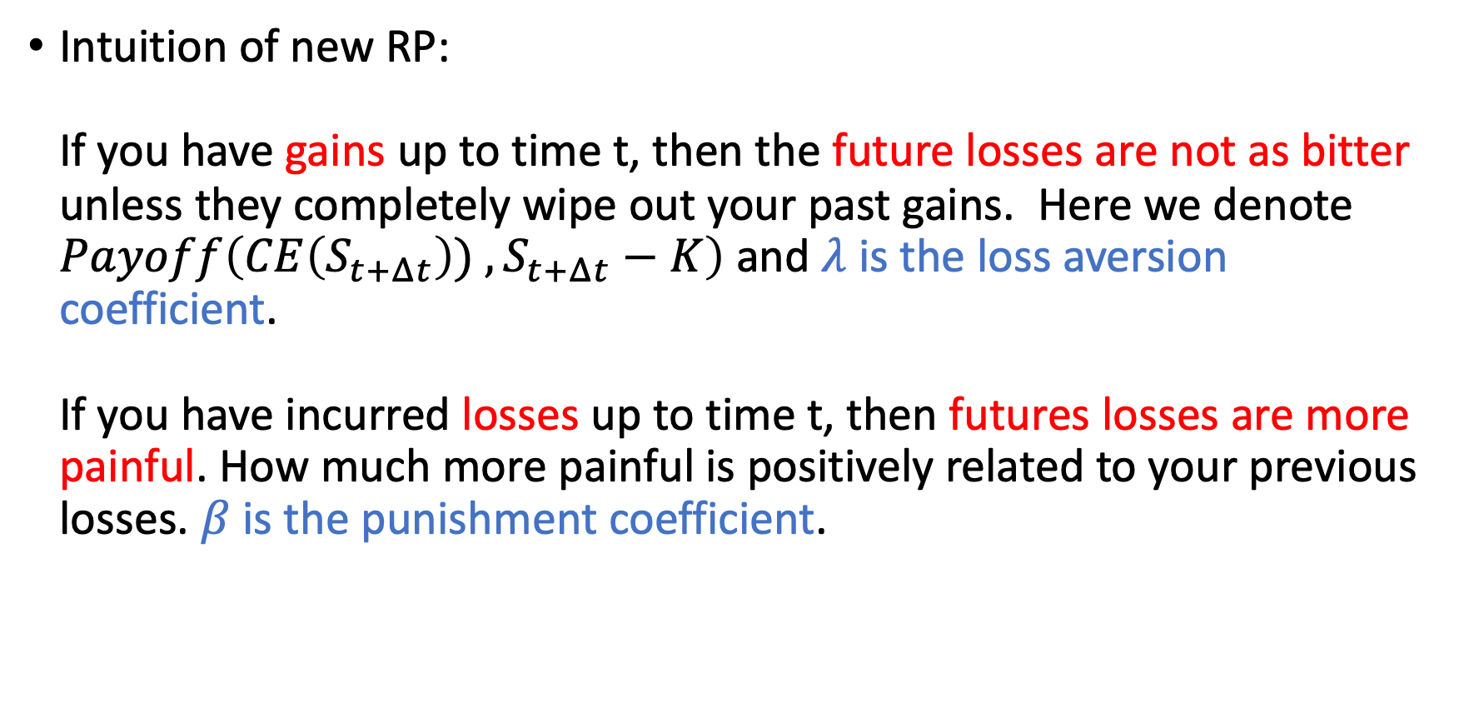
Cumulative Prospect Theory model
Intuition of new RP: If you have gains up to time t, then the future losses are not as bitter unless they completely wipe out your past gains. Here we denote $Payoff\left(CE\left(S_{t+Δt}\right)) , S_{t+Δt}−K\right)$ and $λ$ is the loss aversion coefficient. If you have incurred losses up to time t, then futures losses are more painful. How much more painful is positively related to your previous losses. $β$ is the punishment coefficient.

Slide 12
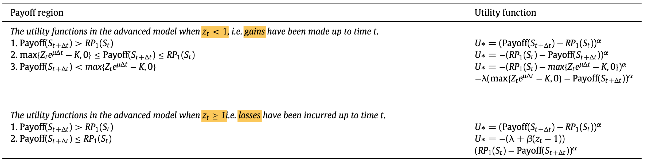
Cumulative Prospect Theory model
Utility function

Slide 13
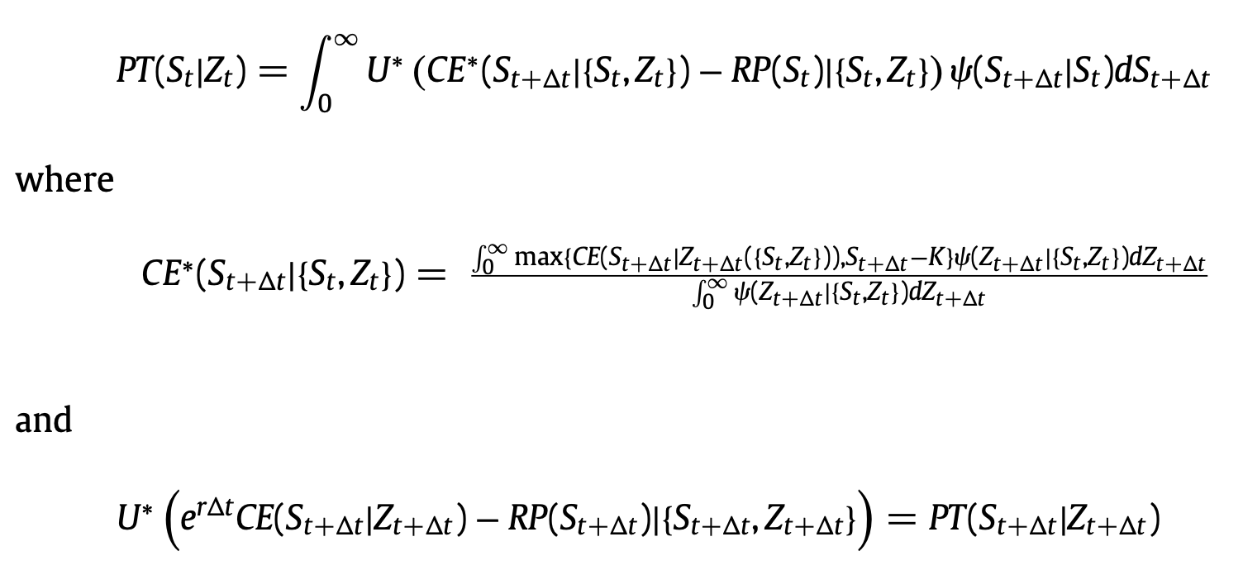
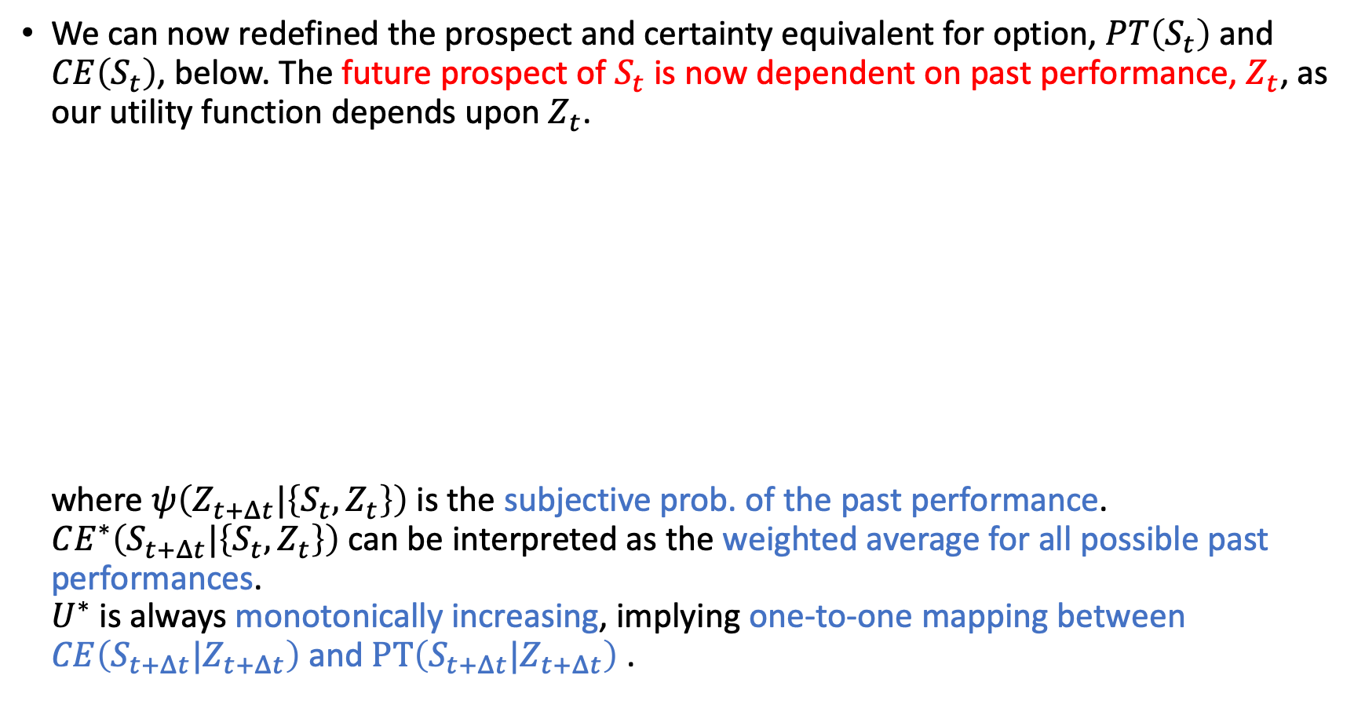
Cumulative Prospect Theory model
We can now redefined the prospect and certainty equivalent for option, $PT\left(S_{t}\right)$ and $CE\left(S_{t}\right)$, below. The future prospect of $S_{t}$ is now dependent on past performance, $Z_{t}$, as our utility function depends upon $Z_{t}$. where $ψ\left(Z_{t+Δt}|\left\{S_{t},Z_{t}\right\}\right)$ is the subjective prob. of the past performance. $CE^{∗}\left(S_{t+Δt}|\left\{S_{t},Z_{t}\right\}\right)$ can be interpreted as the weighted average for all possible past performances. $U^{∗}$ is always monotonically increasing, implying one-to-one mapping between $CE\left(S_{t+Δt}|Z_{t+Δt}\right)$ and $PT\left(S_{t+Δt}|Z_{t+Δt}\right)$ .

